Slide 1
LAN Connections
Accessing Remote Devices

Slide 2
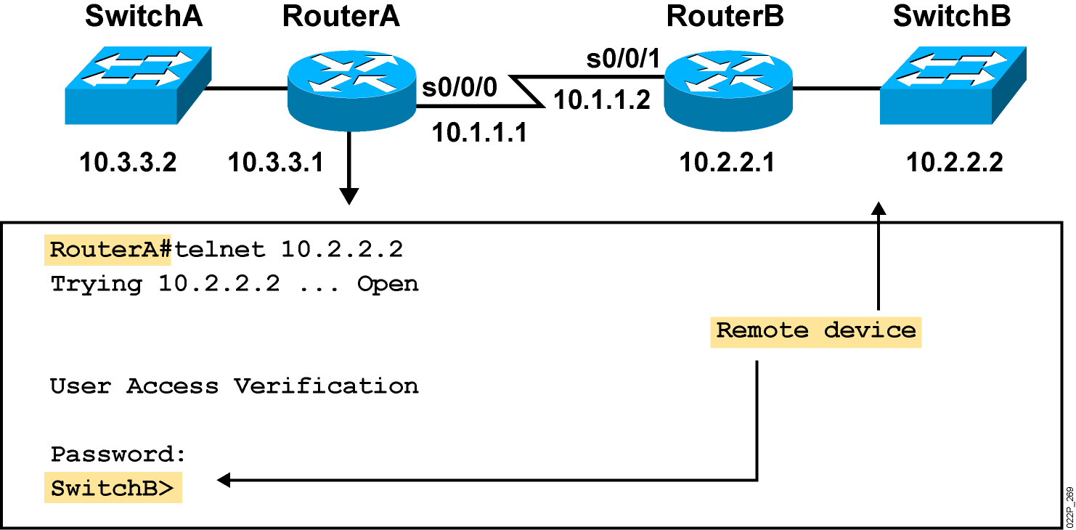
Using Telnet to Connect to Remote Devices
Notes:
Emphasize: Another way to learn about a remote device is to connect to it. Telnet, a virtual terminal protocol that is part of the TCP/IP protocol suite, allows connections to remote hosts. By default, a router can have up to five simultaneous incoming Telnet sessions. With Cisco’s implementation of TCP/IP, you need not enter the connect or telnet command to establish a Telnet connection. If you prefer, you can just enter the learned host name, and the router will resolve the host name using DNS or a local host table. To end a Telnet session, use the exit or logout EXEC command.
These are alternate commands for the operations listed on the graphic:
Initiate a session:
Denver> connect paris
Denver> paris
Denver> 131.108.100.152
Resume a session (enter session number or name):
Denver> 1
Paris>
End a session:
Paris> exit
Note: The Catalyst 1900 can accept incoming Telnet connections but cannot initiate an outgoing Telnet session.

Slide 3
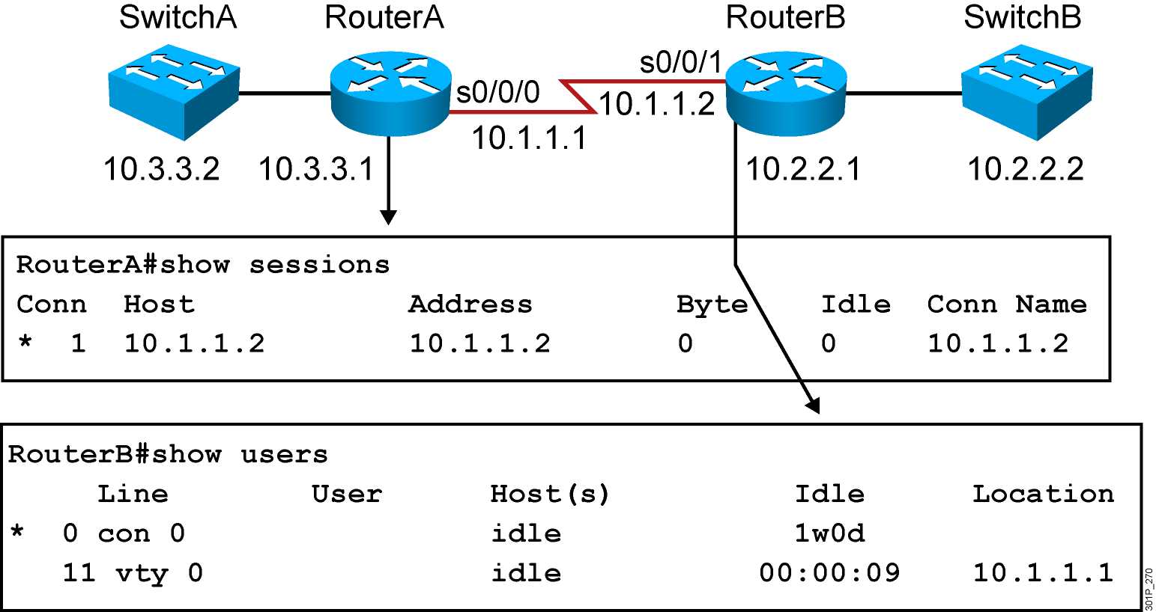
Viewing Telnet Connections
Notes:
Note: This output was taken from a 2522. Line 11 = vty 0.
You can send messages to one or all terminal lines. A common reason for doing this is to inform users of an impending shutdown. To send a message to other terminals, issue the following command:
send {line-number | *}
where line-number specifies the line number to which the message will be sent, and * indicates that the message will be sent to all lines.
The system prompts for the message, which can be up to 500 characters long. End the message by entering Ctrl-Z. Enter Ctrl-C to abort the command.

Slide 4
Viewing SSH Connections
RouterB# show ssh
Connection Version Encryption State Username
0 1.5 3DES Session Started guest
Notes:
Note: This output was taken from a 2522. Line 11 = vty 0.
You can send messages to one or all terminal lines. A common reason for doing this is to inform users of an impending shutdown. To send a message to other terminals, issue the following command:
send {line-number | *}
where line-number specifies the line number to which the message will be sent, and * indicates that the message will be sent to all lines.
The system prompts for the message, which can be up to 500 characters long. End the message by entering Ctrl-Z. Enter Ctrl-C to abort the command.

Slide 5
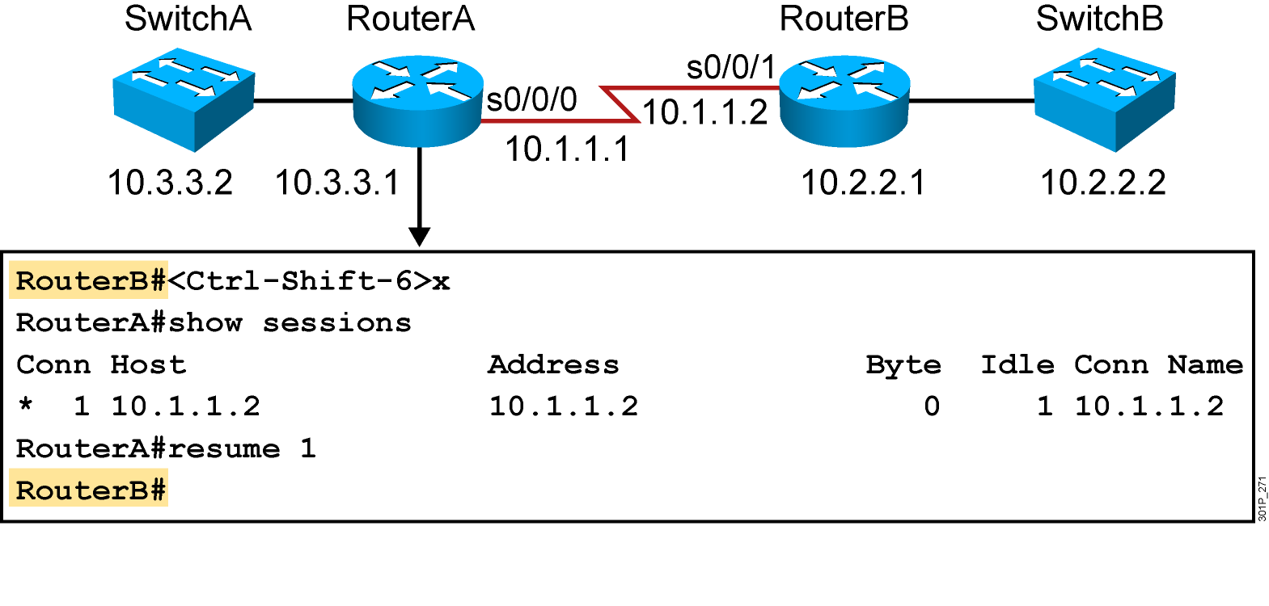
Suspending and Resuming a Telnet Session
Notes:
Emphasize: The key stroke sequence for Ctrl-Shift-6 and x.

Slide 6
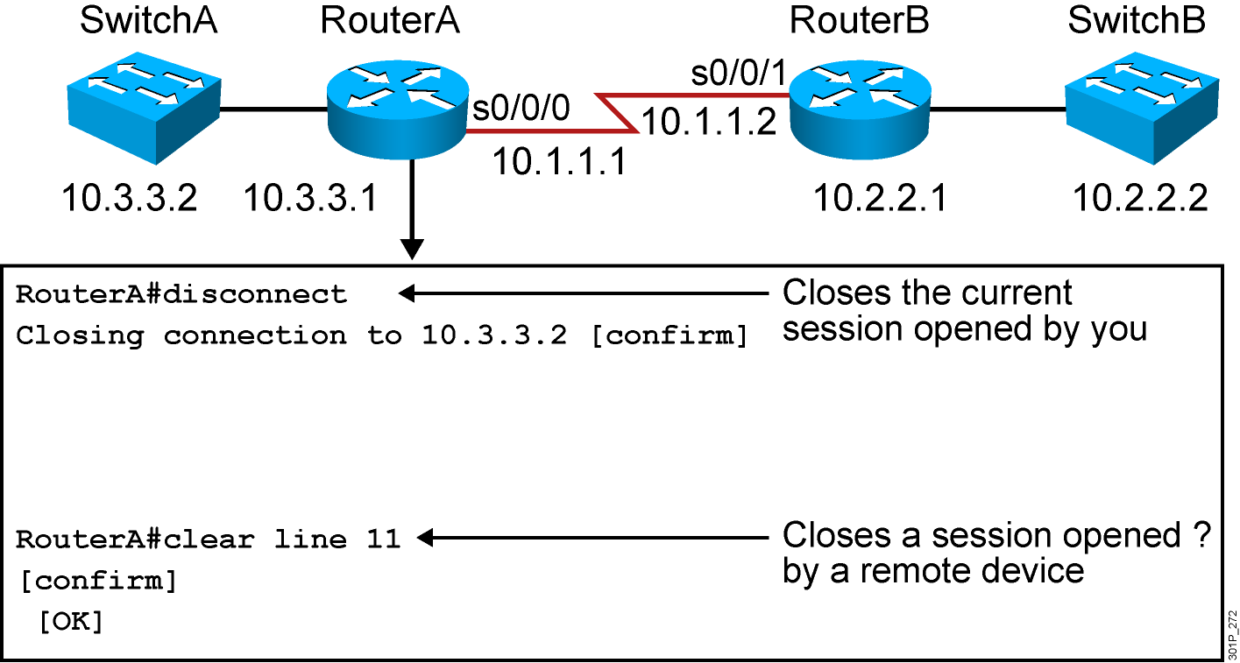
Closing a Telnet Session
Notes:
Note: Disconnecting without the session number disconnects that last active session.

Slide 7
Using the ping and traceroute Commands
RouterX#ping 10.1.1.10
Type escape sequence to abort.
Sending 5, 100-byte ICMP Echos to 10.1.1.10, timeout is 2 seconds:
!!!!!
Success rate is 100 percent (5/5), round-trip min/avg/max = 4/4/4 ms
RouterX#trace 192.168.101.101
Type escape sequence to abort.
Tracing the route to 192.168.101.101
1 p1r1 (192.168.1.49) 20 msec 16 msec 16 msec
2 p1r2 (192.168.1.18) 48 msec * 44 msec
RouterX
Tests the connectivity and path to a remote device
Notes:
Emphasize: As you use CDP and Telnet, you should note the information retrieved from the devices you successfully contacted. Documenting that information helps put the network into a visual perspective, and can be referenced at a later time.
This concludes the network discovery portion of the chapter. In the next section, we will discuss configuration file and Cisco IOS image management.

Slide 8
Summary
  Once connected to a remote device, you may want to access a local device without terminating the Telnet session. Telnet allows temporary suspension and then resumption of a remote session.
  Ending a Telnet session on a Cisco device uses the exit, logout, disconnect, or clear commands.
  The ping and trace commands provide information about the connectivity with and path to remote devices.
Notes:
Purpose: This slide discuss the initial configurations on the routers and switches.
Note: There is no setup mode on the Catalyst 1900 switch.

